Slide 1
Objectives
In this session, you will learn to:
  Create static variables, methods, and initializers
  Create final classes, methods, and variables
  Create and use enumerated types
  Use the static import statement
  Create abstract classes and methods
  Create and use an interface
  Define exceptions
  Use try, catch, and finally statements
  Describe exception categories
  Identify common exceptions
  Use assertions
  Distinguish appropriate and inappropriate uses of assertions
  Enable assertions at runtime

Slide 2
The static Keyword
The static keyword is used as a modifier on variables, methods, and nested classes.
The static keyword declares the attribute or method is associated with the class as a whole rather than any particular instance of that class.
Thus, static members are often called class members, such as class attributes or class methods.

Slide 3
The static Keyword (Contd.)
Static attribute:
  A public static class attribute can be accessed from outside the class without an instance of the class.
Static method:
  A static method can be invoked without creating the instance of the class.
  Static methods can not access instance variables.
Static initializers:
  A class can contain code in a static block that does not exist within a method body.
  Static block code executes once only, when the class is loaded.
  Usually, a static block is used to initialize static (class) attributes.

Slide 4
Demo: The static Keyword
Let us see the demonstration of the concept of static keyword.

Slide 5
The final Keyword
The final keyword is used for security reasons.
It is used to create classes that serve as a standard.
It implements the following restrictions:
  You cannot subclass a final class.
  You cannot override a final method.
  A final variable is a constant.
  All methods and data members in a final class are implicitly final.

Slide 6
The final Keyword (Contd.)
A blank final variable is a final variable that is not initialized in its declaration. The initialization is delayed.
A blank final instance variable must be assigned in a constructor, but it can be set once only.
A blank final variable that is a local variable can be set at any time in the body of the method, but it can be set once only.

Slide 7
Enumerated Types
An enum type field consist of a fixed set of constants.
You can define an enum type by using the enum keyword.
The enum class body can include methods and other fields.
The following code snippet displays the use of enum type:
  public enum Day { SUNDAY, MONDAY, TUESDAY, WEDNESDAY, THURSDAY, FRIDAY, SATURDAY }
The compiler automatically adds some special methods when it creates an enum.

Slide 8
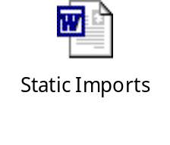
Static Imports
Static import feature enables unqualified access to static members without having to qualify them with the class name.
Let us understand the concept of static imports by using the embedded document.

Slide 9
Abstract Classes
An abstract class is declared with abstract access specifier and it may or may not include abstract methods.
Abstract classes cannot be instantiated, but they can be subclassed.
An abstract class defines the common properties and behaviors of other classes.
It is used as a base class to derive specific classes of the same type.

Slide 10
Interfaces
Interfaces are used to define a behavior protocol that can be implemented by any class anywhere in the class hierarchy.
A public interface is a contract between client code and the class that implements that interface.
A Java interface is a formal declaration of such a contract in which all methods contain no implementation.
Many unrelated classes can implement the same interface.
A class can implement many unrelated interfaces.
All methods declared in an interface are public and abstract.

Slide 11
Demo: Interfaces
Let us see the demonstration of the concept of interfaces.

Slide 12
Exceptions and Assertions
Exceptions are a mechanism used to describe what to do when something unexpected happens. For example:
  When a method is invoked with unacceptable arguments
  When a network connection fails
  When the user asks to open a non-existent file
Assertions are a way to test certain assumptions about the logic of a program. For example:
  To test a variable for a positive value at a particular point of time.

Slide 13
Exceptions
The Java programming language provides two broad categories of exceptions:
  Checked
  Unchecked
Checked exceptions are those that the programmer is expected to handle in the program, and that arise from external conditions that can readily occur in a working program.
Unchecked exceptions might arise from conditions that represent bugs, or situations that are considered generally too difficult for a program to handle reasonably.
Exceptions that arise from a category of situations that probably represent bugs are called runtime exceptions.

Slide 14
Exceptions (Contd.)
Exceptions that arise as a result of environmental issues that are rare enough or hard enough to recover from are called errors.
The Exception class is the base class that represents checked and unchecked exceptions.
The Error class is the base class used for the unchecked, serious error conditions from which your program is not expected to attempt recovery.
The RuntimeException class is the base class that is used for the unchecked exceptions that might arise as a result of program bugs.

Slide 15
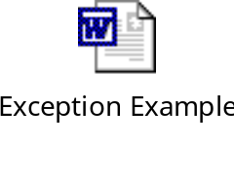
Exception Example
Let us understand the concept of exception by using the embedded document.

Slide 16
The try-catch Statement
The try-catch block:
  The try block governs the statements that are enclosed within it and defines the scope of the exception-handlers associated with it.
  A try block must have at least one catch block that follows it immediately.
  The catch statement takes the object of the exception class that refers to the exception caught, as a parameter.
  Once the exception is caught, the statements within the catch block are executed.
  The scope of the catch block is restricted to the statements in the preceding try block only.

Slide 17
Call Stack Mechanism
If an exception is not handled in the current try-catch block, it is thrown to the caller of the method.
If the exception gets back to the main method and is not handled there, the program is terminated abnormally.

Slide 18
The finally Clause
The finally clause defines a block of code that always executes, regardless of whether an exception is thrown.

Slide 19
Exceptions Categories
The java.lang.Throwable class acts as the parent class for all objects that can be thrown and caught using the exception-handling mechanisms.

Slide 20
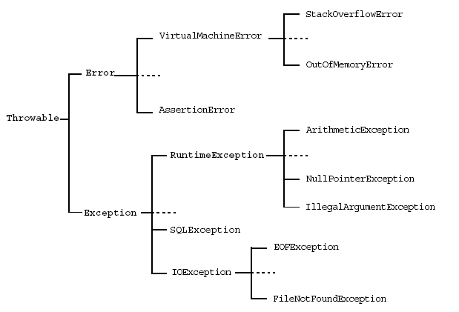
Exceptions Categories (Contd.)
The following figure displays the exception hierarchy of Throwable class.

Slide 21
Common Exceptions
The common exceptions are:
  NullPointerException
  FileNotFoundException
  NumberFormatException
  ArithmeticException
  SecurityException

Slide 22
Method Overriding and Exceptions
When overriding a method that throws exceptions, the overriding method can declare only exceptions that are either the same class or a subclass of the exceptions.
It is permitted to declare that an overriding method throws fewer exceptions than the superclass method, including no exceptions at all.

Slide 23
Creating Your Own Exceptions
User-defined exceptions are created by extending the Exception class.
The extended class contains constructors, data members and methods.
The throw and throws keywords are used while implementing user-defined exceptions.

Slide 24
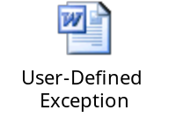
Throwing a User-Defined Exception
Let us understand the concept of a user-defined exception by using the embedded document.

Slide 25
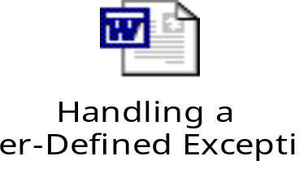
Handling a User-Defined Exception
Let us understand concept of handling a user-defined exception by using the embedded document.

Slide 26
Assertions
Two syntactic forms for assertion statements are:
  assert <boolean_expression> ;
  assert <boolean_expression> : <detail_expression> ;
Recommended uses of assertions:
  Use assertions to document and verify the assumptions and internal logic of a single method:
    Internal invariants
    Control flow invariants
    Postconditions and class invariants
Inappropriate uses of assertions:
  Do not use assertions to check the parameters of a public method.
  Do not use methods in the assertion check that can cause side-effects.

Slide 27
Assertions (Contd.)
By default, assertions are disabled.
To turn assertions on, use either of these forms:
  java -enableassertions MyProgram
  java -ea MyProgram

Slide 28
Summary
In this session, you learned that:
  The static keyword declares members (attributes, methods, and nested classes) that are associated with the class rather than the instances of the class.
  final classes cannot be subclassed, final methods cannot be overriden, and final variables are constant.
  An enum type is a type whose fields consist of a fixed set of constants.
  Static import feature enables unqualified access to static members without having to qualify them with the class name.
  An abstract class defines the common properties and behaviors of other classes. It is used as a base class to derive specific classes of the same type.
  Interfaces are used to define a behavior protocol that can be implemented by any class anywhere in the class hierarchy.

Slide 29
Summary (Contd.)
  Exceptions are a mechanism used to describe what to do when something unexpected happens.
  You can implement exception handling in your program by using the following keywords:
    try
    catch
    throws/throw
    finally
  Assertions are a way to test certain assumptions about the logic of a program.

